Slide 1
Final Engagement
Attack, Defense & Analysis of a Vulnerable Network

Slide 2
Table of Contents
This document contains the following resources:
Network Topology & Critical Vulnerabilities
Alerts Implemented
Hardening
Implementing Patches

Slide 3

Network Topology
& Critical Vulnerabilities
3

Slide 4
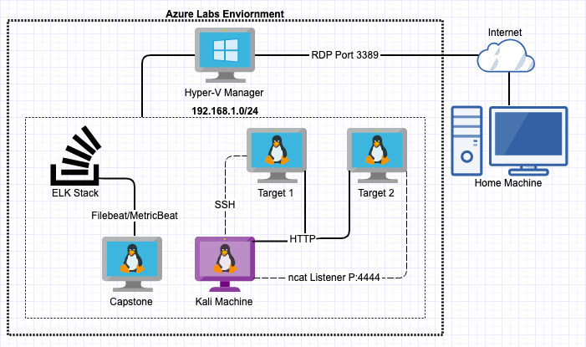
Network Topology
Network
Address Range: 192.168.1.0/24
Gateway: 192.168.1.1
Machines
IPv4: 192.168.1.90
OS: Debian Kali 5.4.0
Hostname: Kali
IPv4: 192.168.1.110
OS: Debian GNU/Linux 8
Hostname: Target 1
IPv4: 192.168.1.115
OS: Debian GNU/Linux 8
Hostname: Target 2
IPv4: 192.168.1.105
OS: Ubuntu 18.04
Hostname: Capstone
IPv4: 192.168.1.100
OS: Ubuntu 18.04
Hostname: ELK

Slide 5
Critical Vulnerabilities: Target 1
Our assessment uncovered the following critical vulnerabilities in Target 1.
Vulnerability | Description | Impact
Weak Passwords | Was able to find passwords using dictionary brute force against web form | Allowed attacker to gain access to protected web directories
Wordpress User Enumeration | Utilized enum4linux to gather user information for the web server | Allows attacker to gather usernames to gain access to the web server
Unprotected and Unsalted Hash | Used Rainbow table to compare an unprotected hash to a corresponding password | Allowed attacker to gain access to WebDav to alter contents of web server
Privilege Escalation | Used Stevens sudo Python access to escalate from ‘Steven to root’ | Allowed privilege escalation to root

Slide 6
Alerts Implemented
6

Slide 7
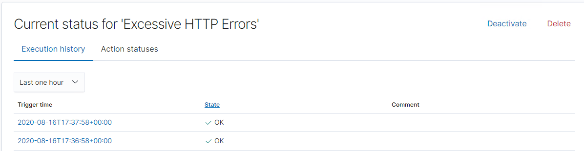
Excessive HTTP Errors
Which metric does this alert monitor?
Count grouped over top 5 ‘http.response.status_code’
What is the threshold it fires at?
Above 400 in 5-minute period
Screenshot of the alert in action:

Slide 8
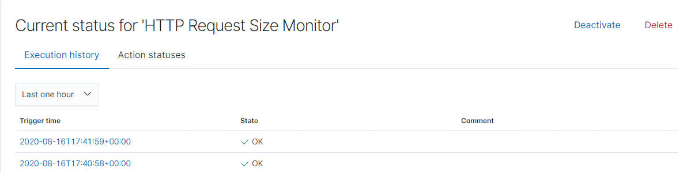
HTTP Request Size Monitor
Which metric does this alert monitor?
Sum of http.request.bytes over all documents
What is the threshold it fires at?
Above 3500 in 1-minute period
Screenshot of the alert in action:

Slide 9
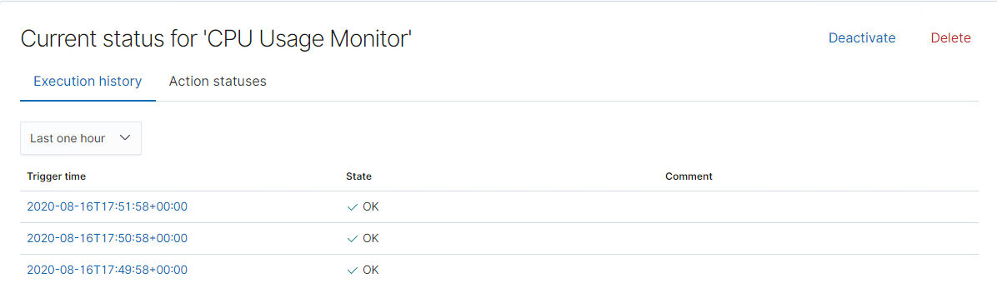
CPU Usage Monitor
Which metric does this alert monitor?
Max of system.process.cpu.total.pct over all documents
What is the threshold it fires at?
Above 0.5 in 5-minute period
Screenshot of the alert in action:

Slide 10
Hardening
10

Slide 11
Hardening Against Wordpress Enumeration on Target 1
How to patch Target 1 against Wordpress Enumeration:
Disable the WordPress REST API and XML-RPC if it’s not needed.
You can also configure the web server to block requests to /?author=<number>.
Prohibit exposure of /wp-admin and /wp-login.php.
Why it works:
WPScan uses REST API to enumerate users.
XML-RPC uses HTTP as it’s transport mechanism for data.
WordPress permalinks can be set to include an author (user) and not exposing WordPress logins adds to brute force attack defense.
How to install it:
Configure WordPress settings and server to achieve these objectives.

Slide 12
Hardening Against Unprotected and Unsalted Hash on Target 1
How to patch Target 1 against Unprotected and Unsalted Hashes:
Thoroughly secure all passwords in the system with protected and salted hashes via password management tools.
Why the patch works:
Salting passwords hides the real hash value by adding an additional bit of data and altering it. This slight alteration makes any brute force attack more challenging to crack.
How to install it:
Implement a good algorithm to implement a strong number generator on your hashes.
OWASP suggests SecureRandom as a cryptographically-strong random data.

Slide 13
Hardening Against Privilege Escalation on Target 1
How to patch Target 1 against Privilege Escalation:
Administrator permissions should be limited to essential personal with privilege given to individuals for specific assignments.
Be aware of hidden administrators.
The local administrator account on workstations and servers.
Service accounts with weak or unchanging passwords.
Why this works:
Limiting access to permissions allows for accountability, thus should there be any compromise, the attacker will not be able to escalate.
How to install it:
In order to prevent user error a good tool to rely on is auditd to aid in finding any compromised accounts.
Ensure proper configuration of the sudoers files.

Slide 14
Implementing Patches
14

Slide 15
Implementing Patches with Ansible
Playbook Overview
One could utilize ansible and a cron job to automate system wide updates as well as keep necessary tools up to date. Ansible can also be used to verify system health (ie. ensuring web servers are up and running)
---
- name: Update apt-get repo and cache
hosts: webservers
apt: update_cache=yes force_apt_get=yes cache_valid_time=3600
- name: Check if reboot is required
- register: reboot_required_file
- stat: path=/var/run/reboot-required get_md5=no

Slide 16
Patch for Unsalted Passwords
The best and only patch for an unsalted password is to add salt
Salt should be added using Cryptographically Secure Pseudo-Random Number Generator (CSPRNG)
These provide higher levels of randomness and unpredictability
Salt also shouldn’t be reused so these tools help make sure that every unique user and password gets its own unique salt.
Good rules of thumb for salt lengths should be the same as the output of the hash function
For example, SHA256 is 32 bytes, so the salt should be at least 32 bytes.
Slow hash functions
This helps prevent brute force attacks or dictionary attacks by making the hash function slower so attackers can’t overpower can’t run through possible hashes as quickly.
Require single use tokens, such as emails directly to user to reset passwords with links that expire and is tied to the user account
Make sure the new password has a new salt attached to it as well

Slide 17
Patches for Privilege Escalation
Robust password requirements for all users
Require longer lengths, special characters and numbers, words not found in dictionary or related to user name, as well as requirements on how often they should be updated.
Another layer is to prevent passwords from being reused.
Enterprise password management tools are also available if budgets permit
These tools can scan your hostnames and IP addresses to identify weak credentials
User and Entity Behavior Analytics (UEBA) tools
These tools provide assistance in discovering compromised identities
Establishes baseline behavior of users by analyzing what and how frequently a user accesses such as resources, data files and services as well as their locations.
Tools allow alerts to be set if users deviate from baseline activity.

Slide 18
Patches for Privilege Escalation
Implement multi-step authentication for data input fields and databases
Encrypt all data in transport and at rest
Require escalation for users to receive write access
Train all users and establish culture of security
Users are more likely to be compliant if they understand vulnerabilities and reasons for things like password requirements and multi-step authentication

